Slide 1


Stock mining
Alpha prediction
Presented By
Navin Prasad

Slide 2


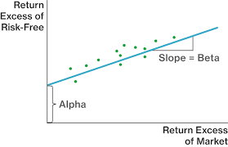
Project Scope:
This project is intended for Predicting the alpha score of a stock, based on the seven influential factors and stock tweets. The project duration was 2 weeks.
The project is segmented into two modules.
Module 1: predicting sentiment score for the stock tweets.
Module 2: predicting the alpha score for all the stocks provided using the final eight influential factors.

Slide 3
Project Objective
The main objective is to build machine learning model to predict the alpha value using sentiment score as a factor, along with other seven influencing factors.
Input Source:
There are three kind of data used for the alpha prediction.
Dataset of seven influential factors with timestamp which is obtained from a hedge fund.
Stock tweets with timestamp obtained from StockTwist.com for sentiment score analysis.
Dataset consisting of Stock ticker with its stock name , sector and its industry obtained from dividendChannel.com

Slide 4
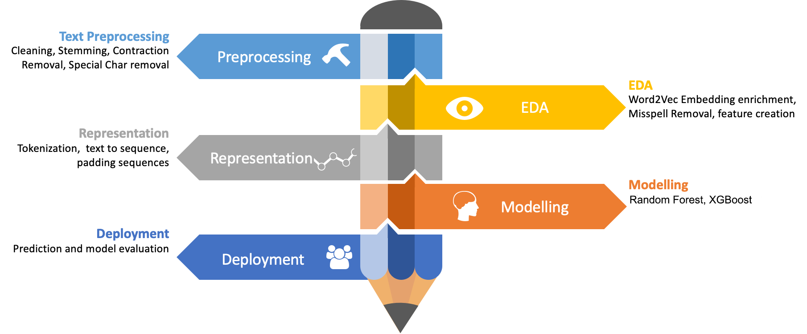
Module 1: Sentiment Score Analysis Approach

Slide 5
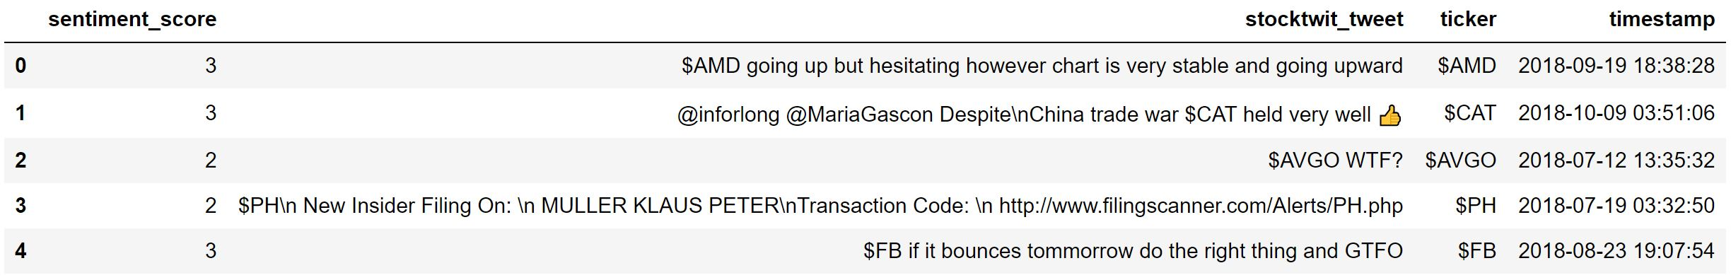
Segment 1: Reading the web Scrapped tweets from Stock Twist json file.
Segment 2: Feature Engineering.
Converting the Attributes to its respective data types.
Checking for Polarity of each tweets and making it as a separate attribute.
Classifying positive, Negative and neutral polarity tweets
Segmenting the data as Daily, Weekly and Monthly for Exploratory data analysis.

Slide 6
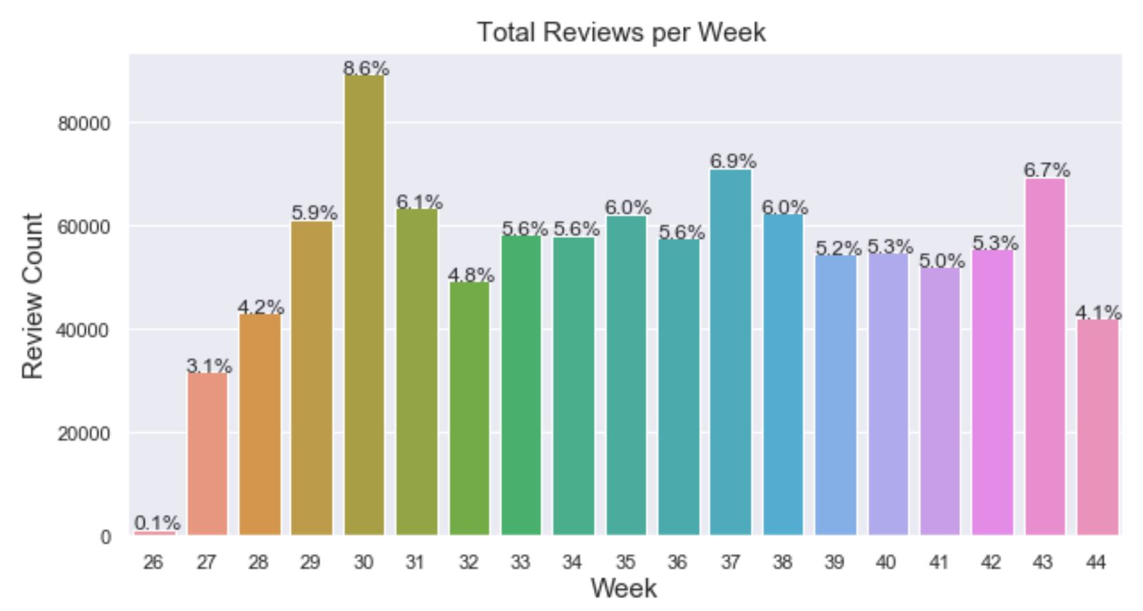
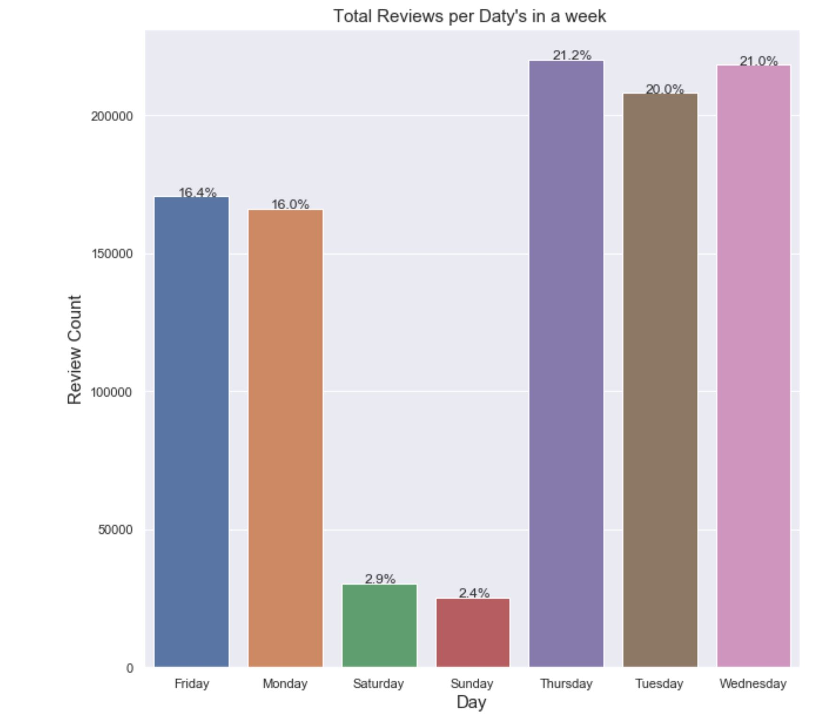
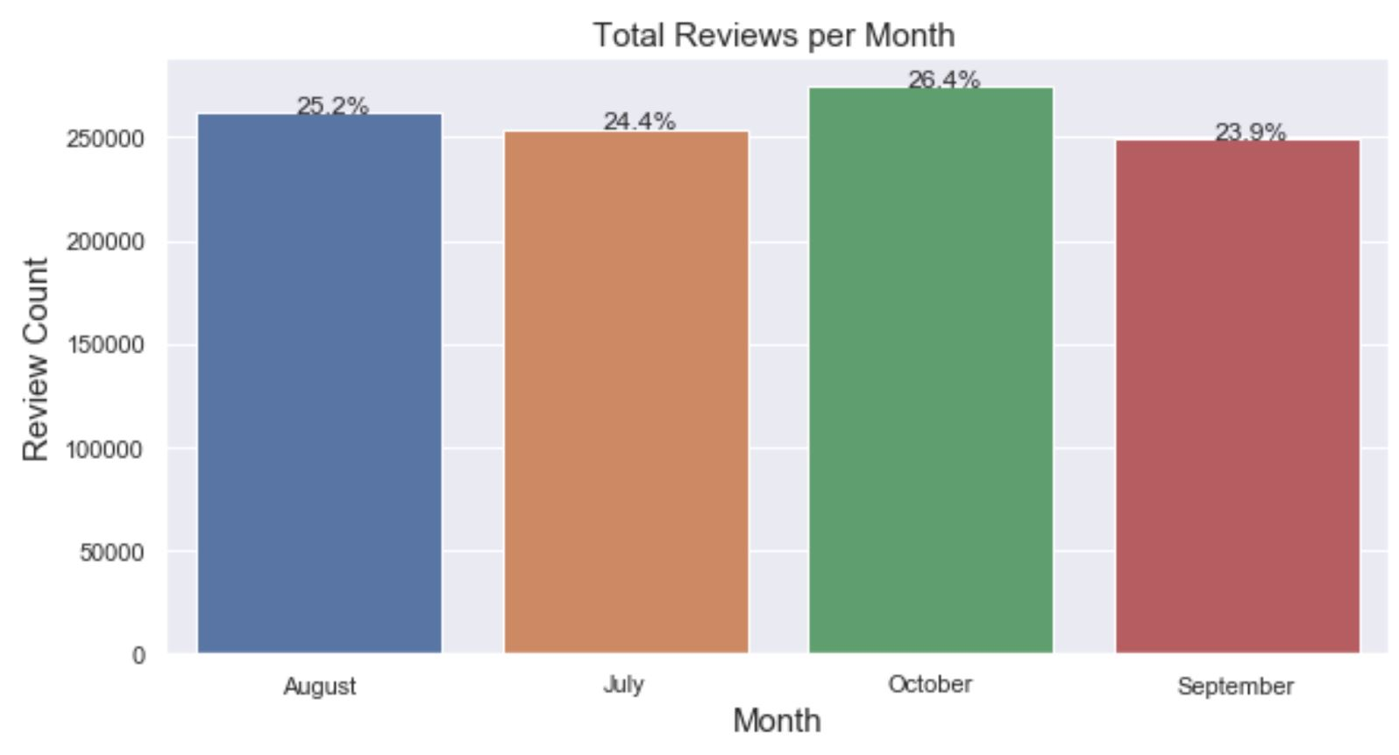

Slide 7
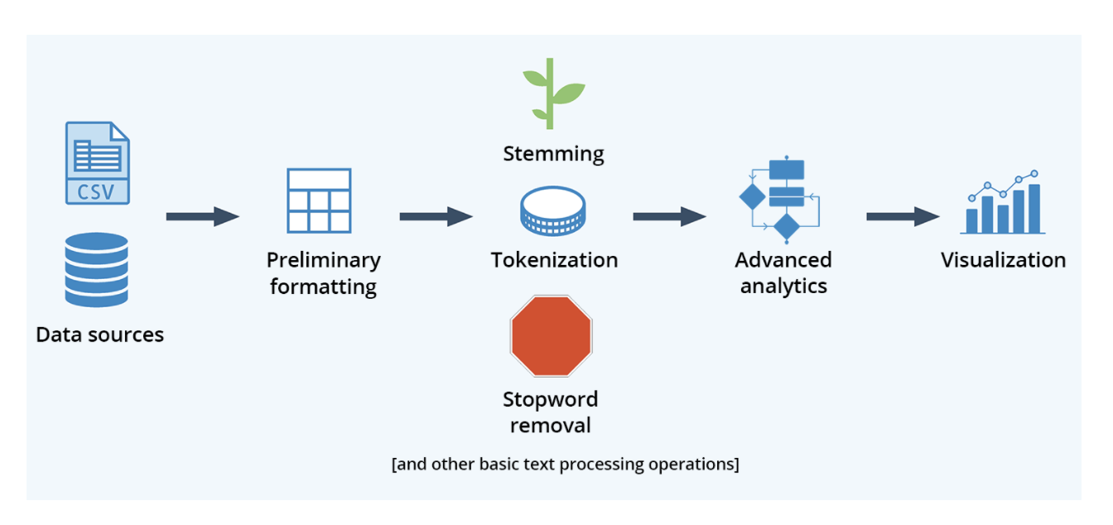
Segment 3: Text Pre-processing:
Step1: Converting all tweets into lower case.
Step2: Using contraction dictionary for Removing localized terms.
Step3: Customizing stop words present in Spacy.
Step4: Removing Scrub words from the tweets.
Step5: Removing accented characters.
Step6: Processing the tweets via Tokenizing, Stemming or Lemmatization.

Slide 8
Segment 4: Train and Validation split
Step 1: Split the Processed tweets into train and validation split. Train = 80% Tweets
Test = 20% Tweets
Step 2: Converting the Tweets to Vectors which will be suitable for modelling.
1. TF-IDF.
2. Word to Vector.
Segment 5: Model Building:
Step 1: Random Forest.
Step 2: XG Boost.
The final F1 score was (0.54) taken from XG boost which provided a better score compared with Random Forest. The sentiment score along with Timestamp where converted in to a Data frame and used as 8th influential factor in predicting Alpha score.

Slide 9
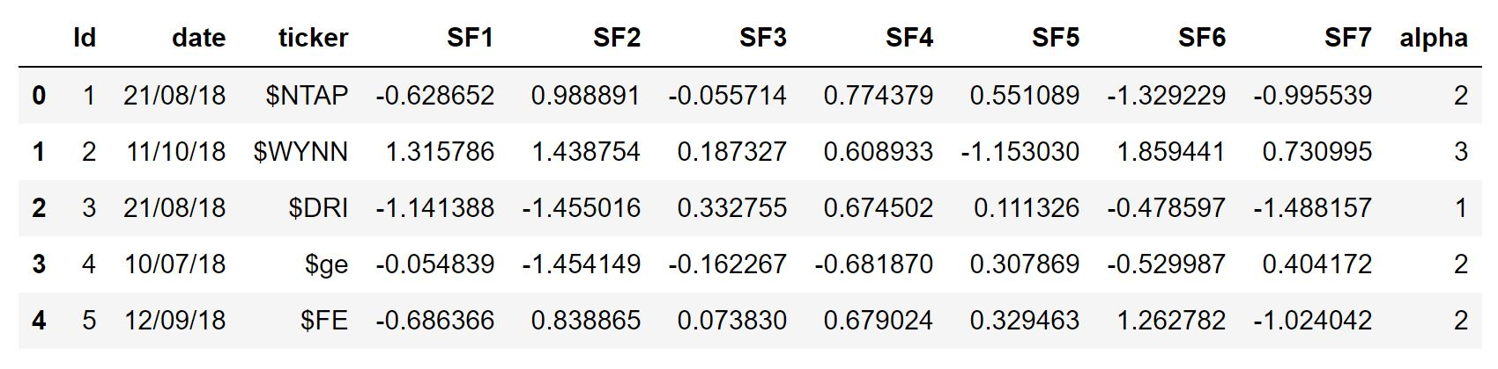
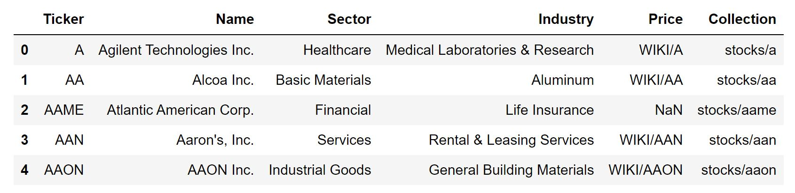
Module 2: Alpha Prediction
Approach:
Segment 1: Reading the Train Alpha data and Stock ticker data from its respective csv files.

Slide 10
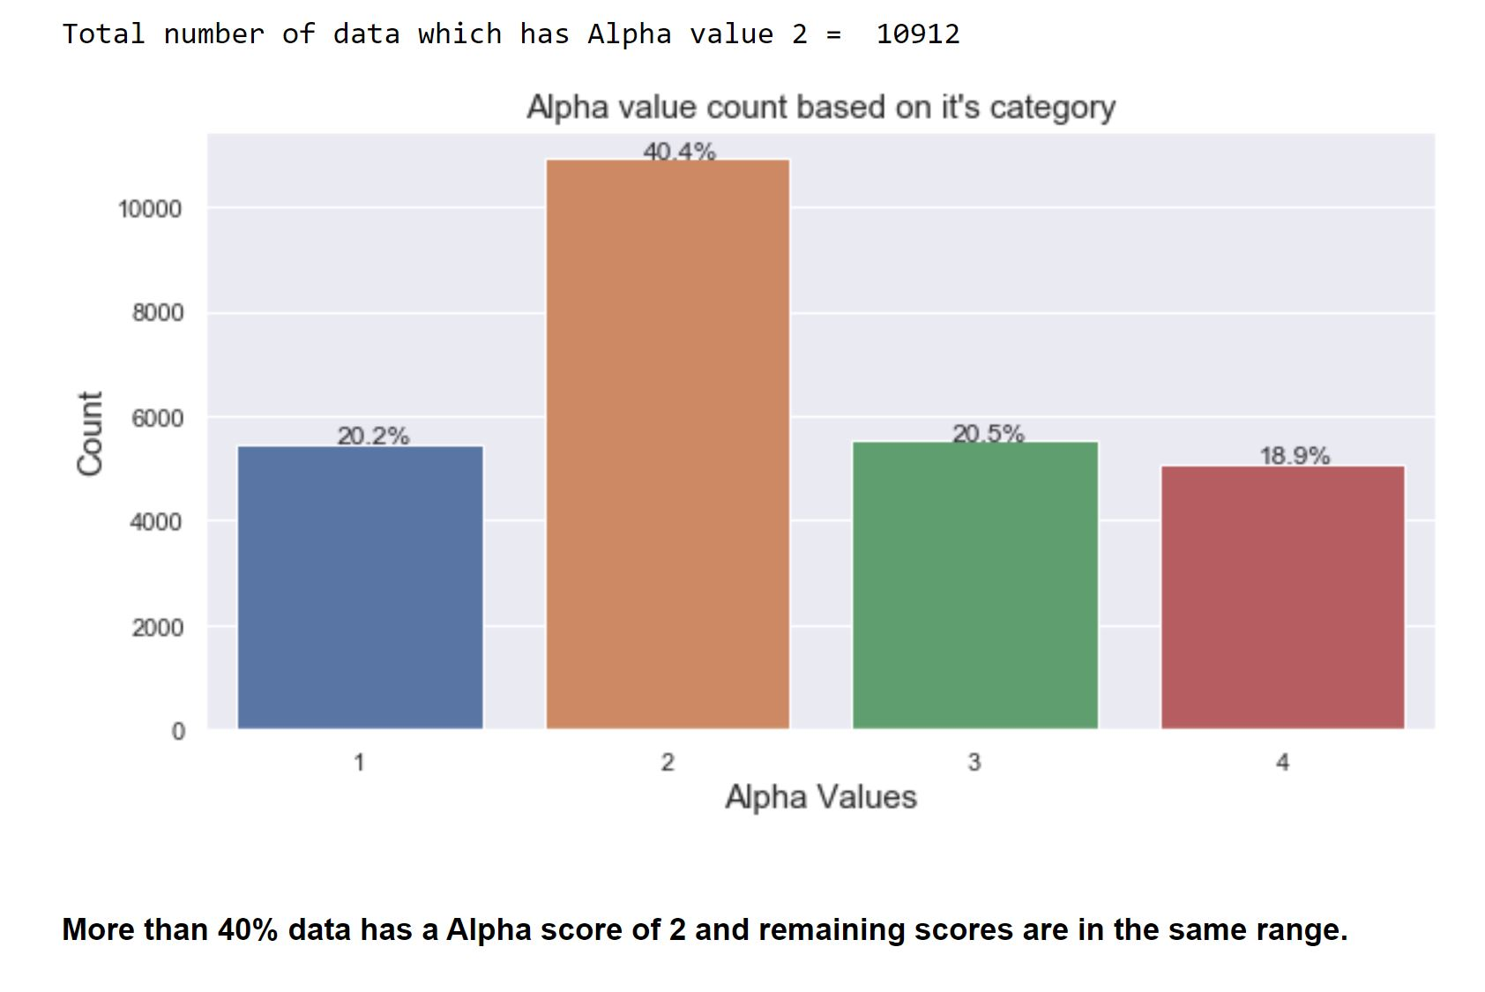
Segment 2: Exploratory data analysis

Slide 11
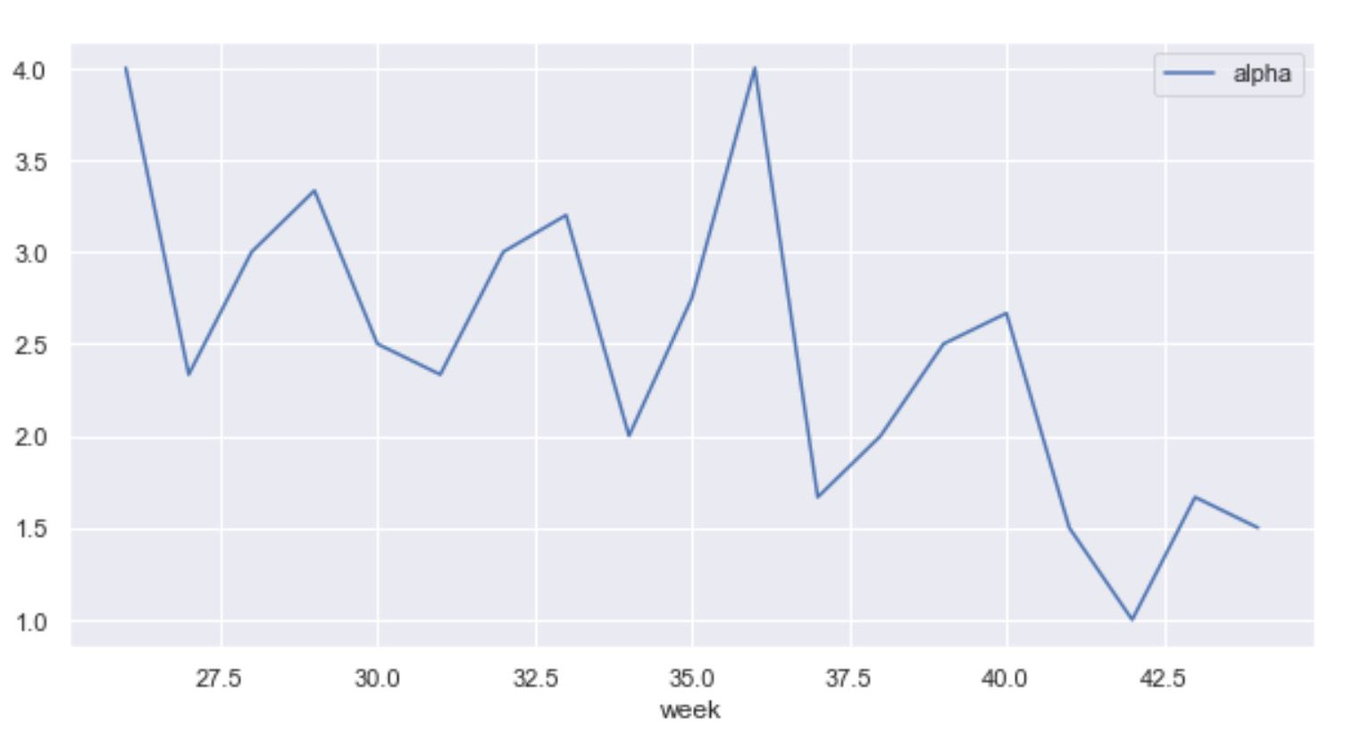
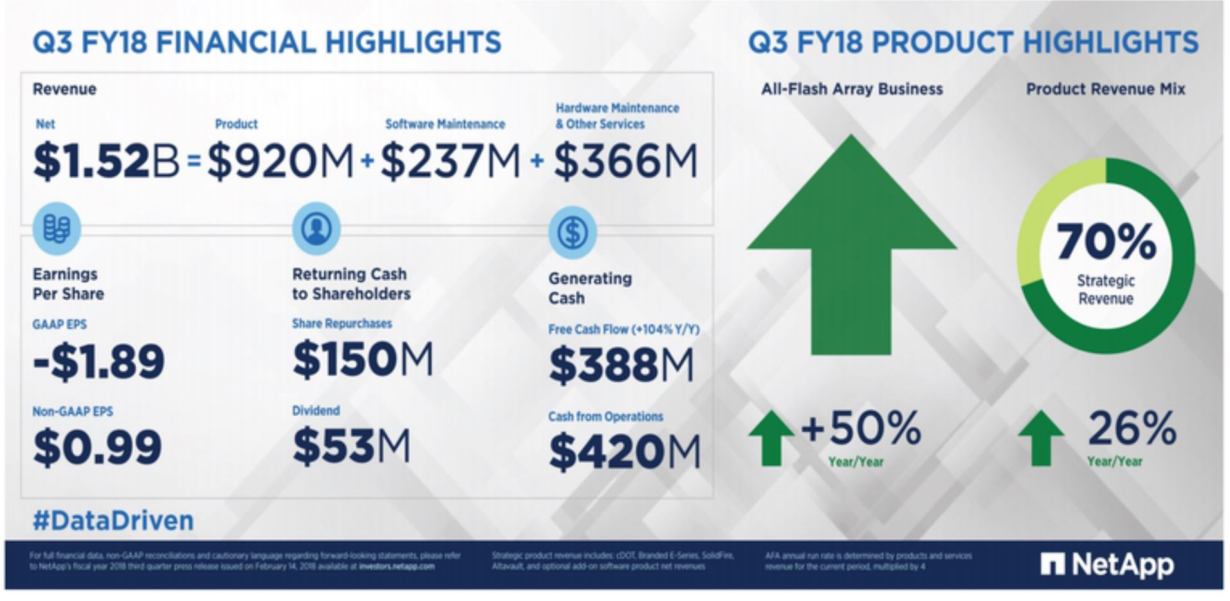
Insight for a Single Entity(Ticker) - NetApp Inc, Amazon and Facebook.
Plotting the Alpha graph for NETAPP:

Slide 12
Q3 Result of NetApp:
NetApp again delivered strong results in the third quarter with accelerating revenue and strong cash generation. It is rewarding to see the results of our improved execution as we transform NetApp to deliver sustained and profitable growth," George Kurian, CEO at NetApp, said in a statement. "We saw a solid demand environment and customer momentum, landing wins and footprint expansions with leading organizations in all geographies. With our Data Fabric Strategy and industry-leading solutions, we are winning new customers and expanding our business opportunity.
For the fourth quarter, the company expects a non-GAAP EPS between 95 cents and 1.03 on revenues in the range of 1.525 billion to 1.675 billion Dollars.
Shares of NetApp were down more than 9 percent in after market trading.
There was a balanced growth in the 3rd quarter of the firm during which the alpha value didn't fluctuate much and remained close to 4. After that in Q4 the expected revenue was met and the Alpha value went lower and remained between 1 and 2 mostly.

Slide 13
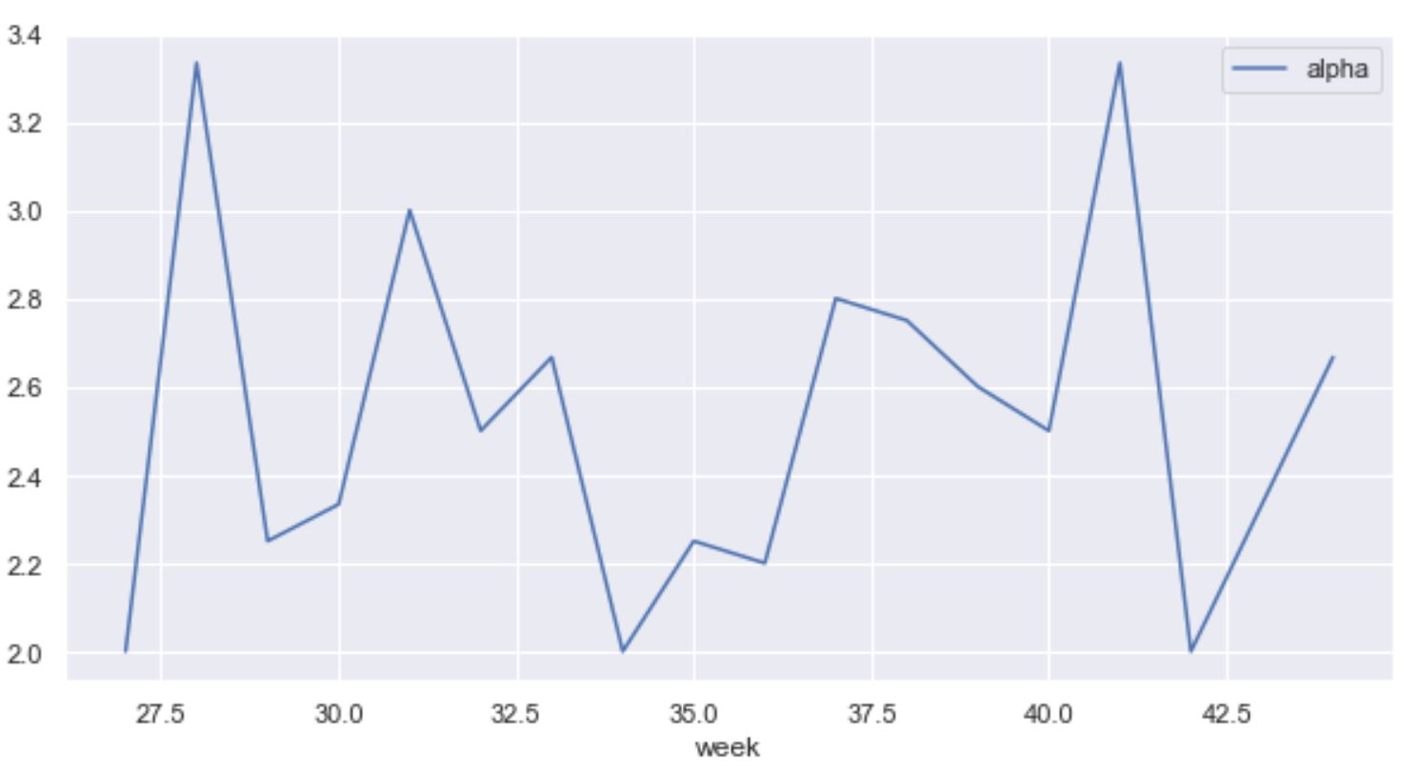
Plotting the Alpha graph for AMAZON: Q3
Amazon has seasonal variations in its Alpha value. The alpha value was in a good shape when the Q2 results where announced and held its position between 2-3 after which there was a light decline in the sales which made the alpha value go down.
In the beginning of the Q4 the alpha value started to rise again due increase in sales(festival season).
reference https://ir.aboutamazon.com/quarterly-results

Slide 14
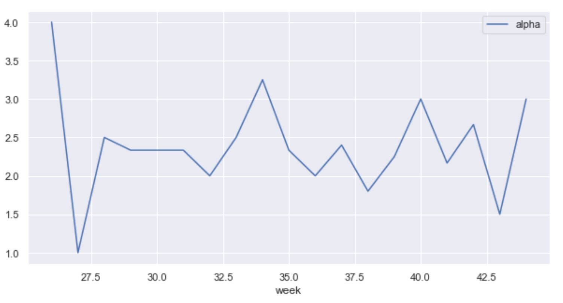
Plotting the Alpha graph for Facebook:
After the poor Facebook's Q2 announcement the alpha value got reduced significantly from 4 to 1. which later gradually picked up and maintained in 2 . The main reason for that drop in Q2 and which prolonged in Q3 is the leak of Fb users personal data.
The users engagement factor was huge at the start and end of the year but remained normal during the other seasons.
Q3 results in Sep end, The number of daily users on the platform also appeared to bounce back, indicating steady engagement despite backlash surrounding the leak of personal information to firms such as Cambridge Analytica. Shares jumped about 6 percent after the results were released.

Slide 15

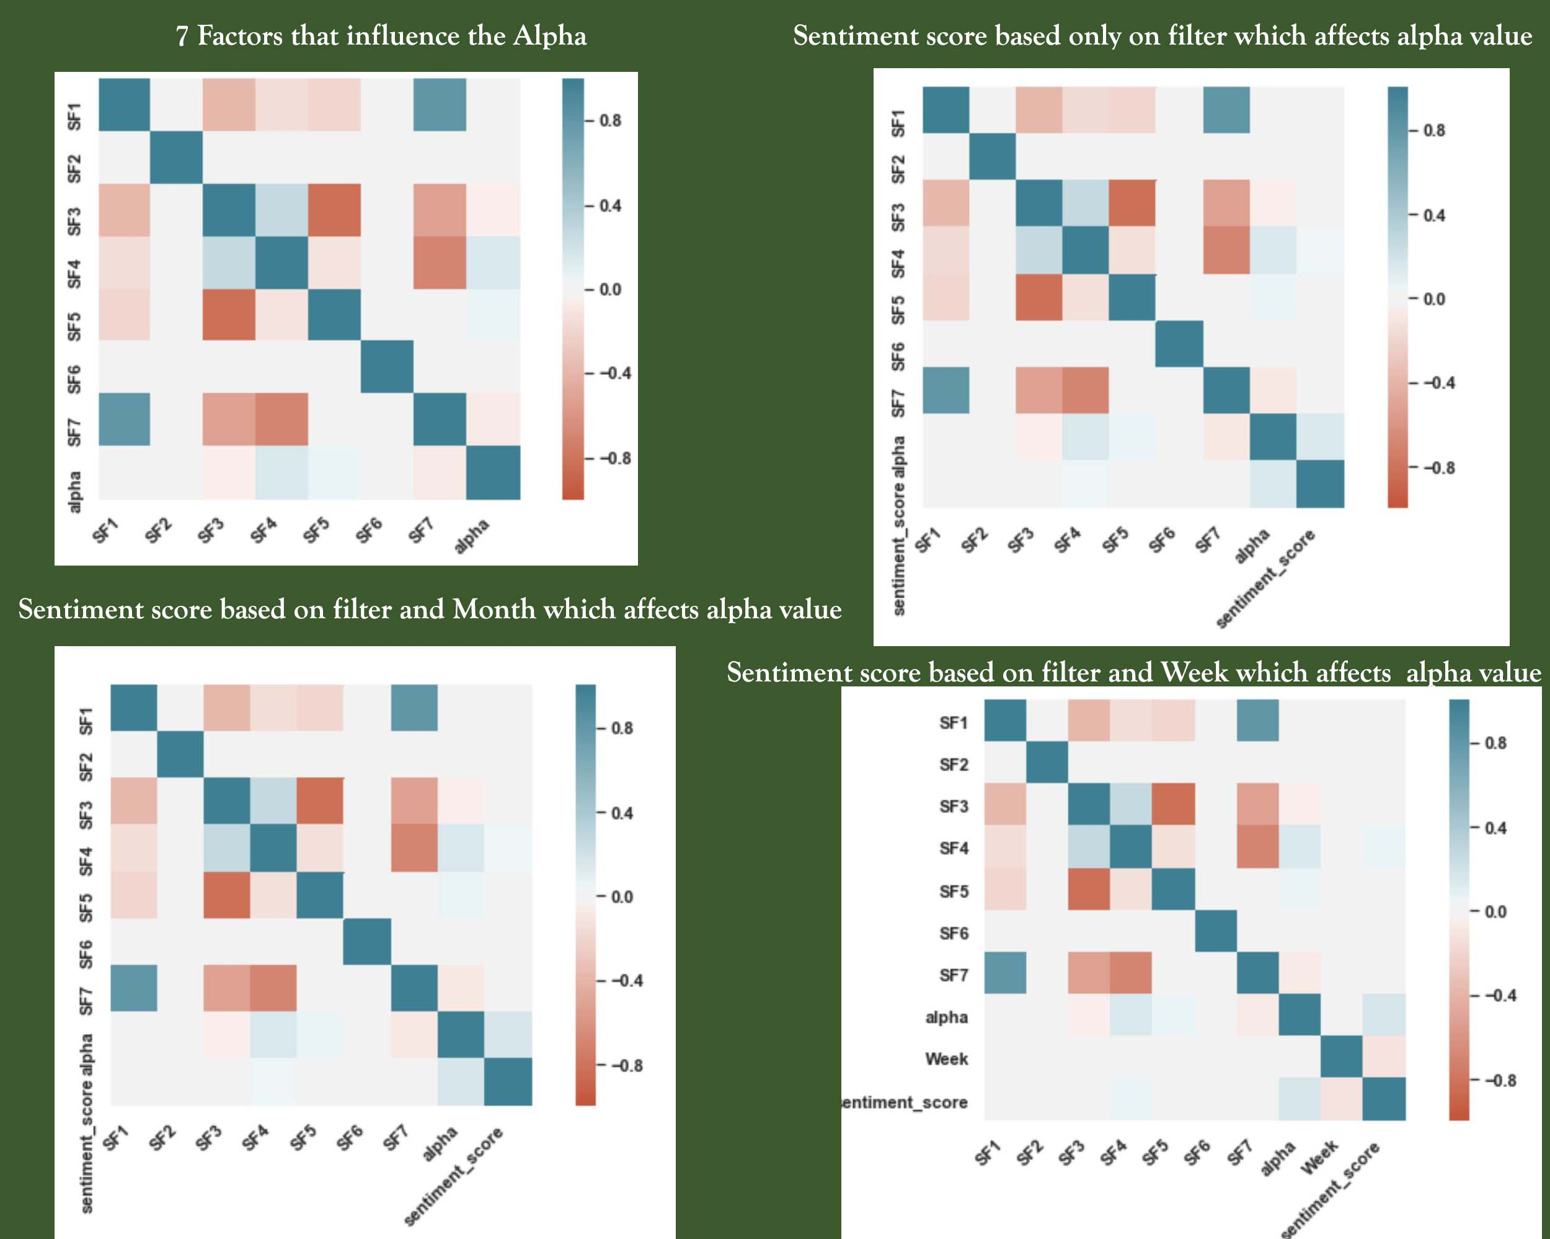
Correlation plot after merging
Sentiment score with seven
other influential factors.

Slide 16
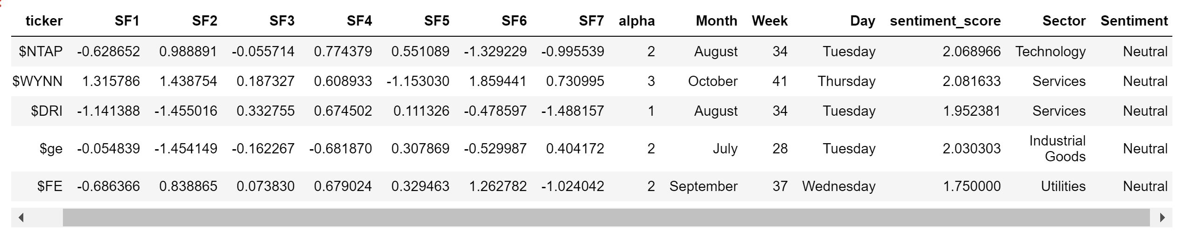
Segment 3: Feature engineering
Step1: Categorizing the sentiment score into Positive, Negative and Neutral sentiment.
Step2: Making Month, week and day as separate attribute from date attribute.
Step3: Merging Average sentiment score with the data frame based on weekly data.
Step4: Adding stock Sector as 9th influential attribute.

Slide 17
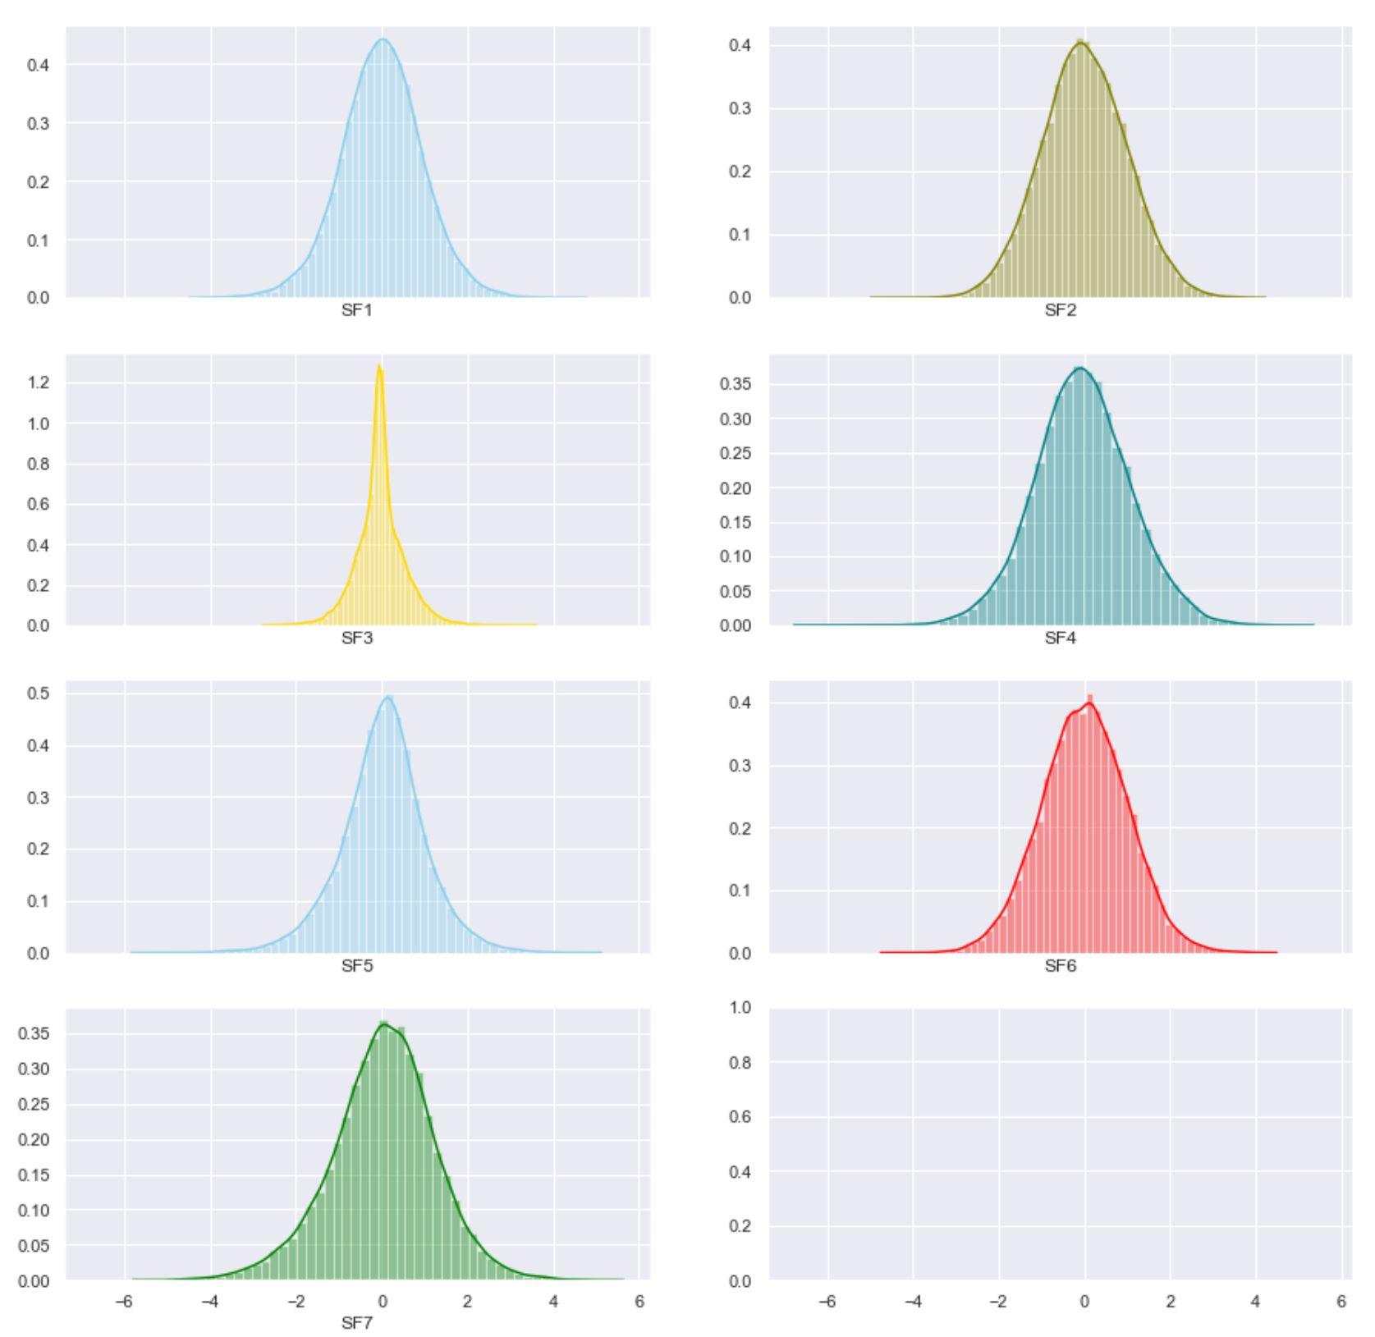
Segment 4: Checking the Data distribution of all seven factors influencing alpha

Slide 18
Segment 5: Data Pre-Processing
Step 1: Train and Validation split.
Step 2: Split Numerical and Categorical variables
Step 3: Imputing Numeric and Categorical Attributes
Step 4: Standardizing the Numerical attributes.
Step 5: Performing one hot encoding for categorical attributes.
Step 6: Applying PCA in the entire dataset to reduce its dimensionality.
Segment 6: Model Building
1. Gaussian Naive Bayes
2. Random Forest
3. Decision Tree
4. Logistic Regression
5. XGB Classifier

Slide 19
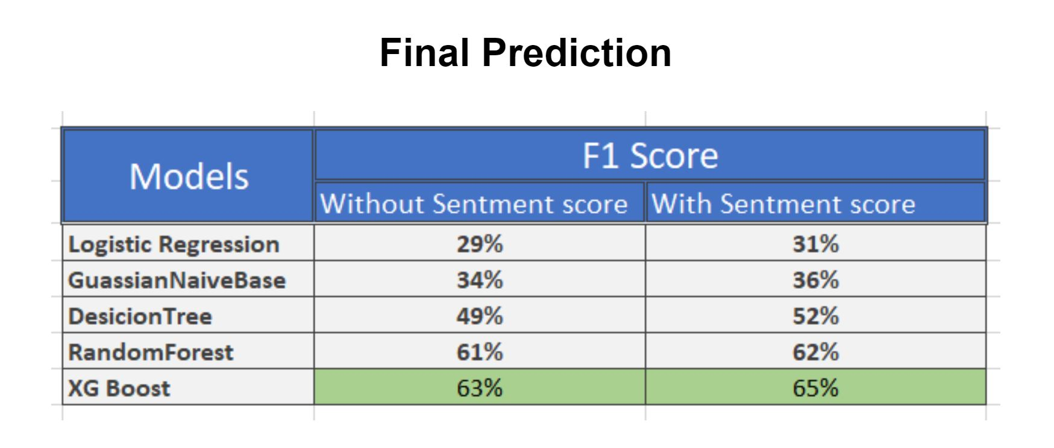

Slide 20


THANK Y U

